Slide 1
A Study of the Price of a Used Ford Car Using Possible Contributing Factors
Eric Yong

Slide 2
Dataset Discussion
General Research Question
Can you use contributing factors to determine the price of a used Ford car?
Ford used car dataset
Dependent Variable - price of the car (y)
Independent Variables
Age (2024 - year) (X1)
Mileage (X2)
Road tax (X3)
MPG (X4)
Engine Size (X5)
Transmission - Manual, Automatic (X6), Semi-Auto (X7)
Fuel type - Petrol, Diesel (X8), Other (X9)

Slide 3
Model Selection and Diagnostics
Model Remedies
Hypothesis Tests
Model necessities
Significance tests
Best subset algorithms
Heteroskedasticity
Normality
Outliers / Points of Influence
Multicollinearity
Box-cox procedure
Weighted least squares
Ridge regression
Robust regression
F statistic
T-value
Confidence Interval

Slide 4
The Interaction Between Fuel Type and Road Tax on Price

Slide 5
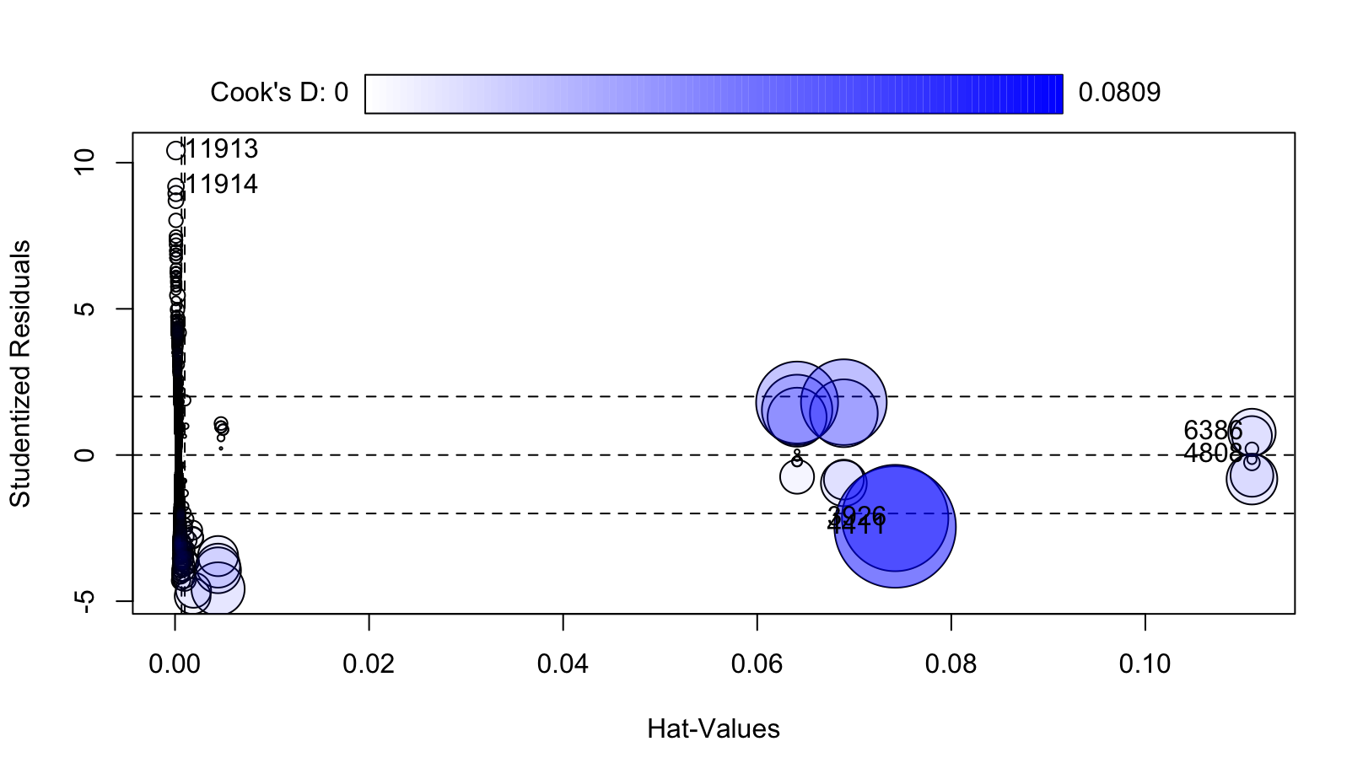
Is the interaction between road tax (X₃) and engine type (Diesel - X₈, Other - X₉) on the price (Y) statistically significant?
Model Selection
Price (Y)
Road tax (X₃)
Fuel type: Diesel (X₈), Other(X₉) (other: electric, hybrid, etc). Baseline: Petrol.
Full model: Y=β3X3+β8X8+β9X9+β38X3X8+β39X3X9+ε
Reduced model: Y=β3X3+β8X8+β9X9
Model Diagnostics
Heteroscedasticity
Breusch-Pagan test: p-value < 2.2e-16
Residual Normality
Shapiro-Wilk test: p-value < 2.2e^-16
Outliers / Points of Influence
Influence plot (Cook’s distance, studentized deleted residual, Hat value)
Indicates many points of influence

Slide 6
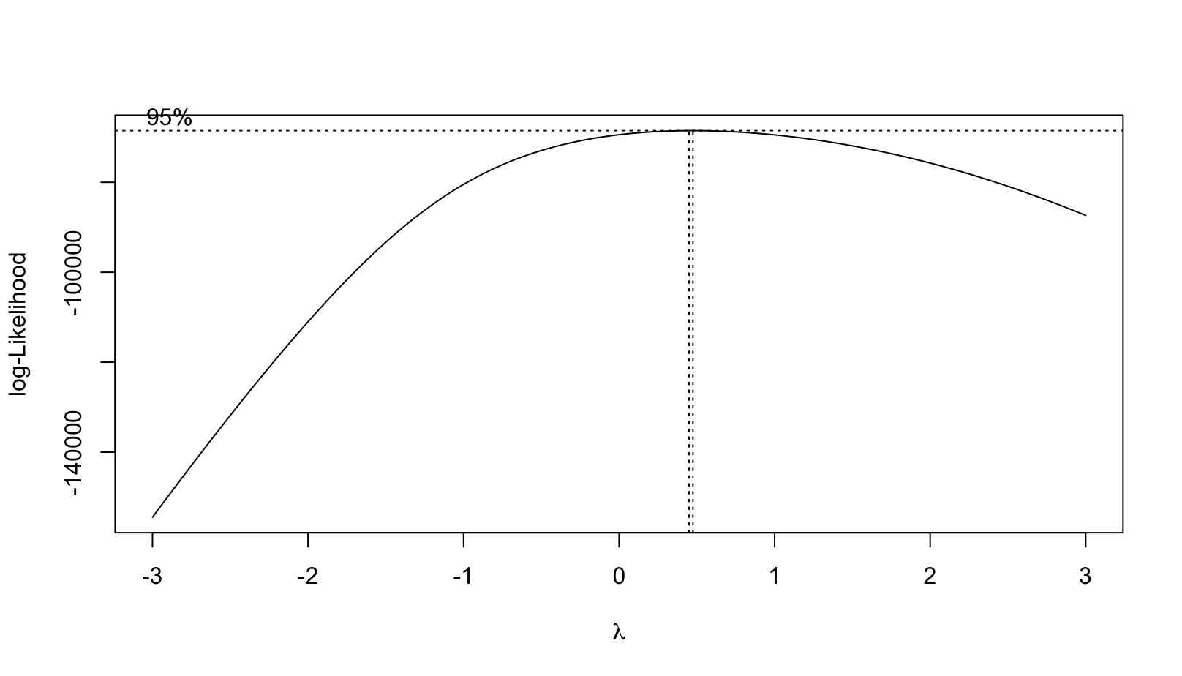
Model Remedies
Robust Regression
Outliers and influence points are still present
Cannot justify use of model.
Box-Cox
Lambda: 0.4545
Breusch-Pagan: p-value < 2.2e^-16
Shapiro-Wilk: p-value < 2.2e^-16
No improvement in R-square value
Didn’t work (made diagnostics worse)
WLS
Breusch-Pagan: p-value = 1
Shapiro-Wilk: p-value < 2.2e^-16
R-squared of 0.3568 (improvement from 0.2498)
Improved model!

Slide 7
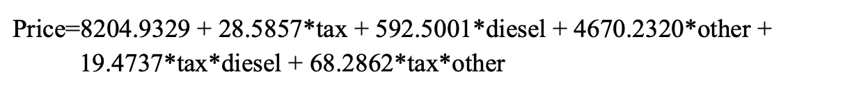
Final Model & Hypothesis Test
Hypothesis Test
H₀: β₃₈=β₃₉=0 Ha: β₃₈≠0 or β₃₉≠0
ANOVA results in a F statistic of 304.35 which resulted in a p-value close to 0.
Conclusion:
The interaction effect between fuel type and road tax on the Ford price is statistically significant.
10-fold cross validation shows RMSE of 4106.679 and R-square of 0.2508439

Slide 8
The Effect of Transmission Type and MPG on Price

Slide 9
How does MPG (X₄) and transmission type (Automatic - X₆, Semi-Auto - X₇) jointly impact the price of used Ford cars in the UK? Is this impact significant?
Model Selection
Price (Y)
MPG (X₄)
Transmission type: Automatic (X₆), Semi-Auto(X₇)
Best subset: adjusted R², Cp, AICp, and SBCp chooses model without Semi-Auto
Stepwise regression: Also chooses model without Semi-Auto
Full model: Y=β4X4+β6X6+β7X7+β46X4X6+β47X4X7+ε
Model Diagnostics
Heteroskedasticity
Residual plot
Breusch-Pagan test: p-value < 2.2e-16
Normality
Normalized Q-Q plot
Shapiro-Wilk test: p-value < 2.2e^-16
Outliers / Points of Influence
Influence plot

Slide 10
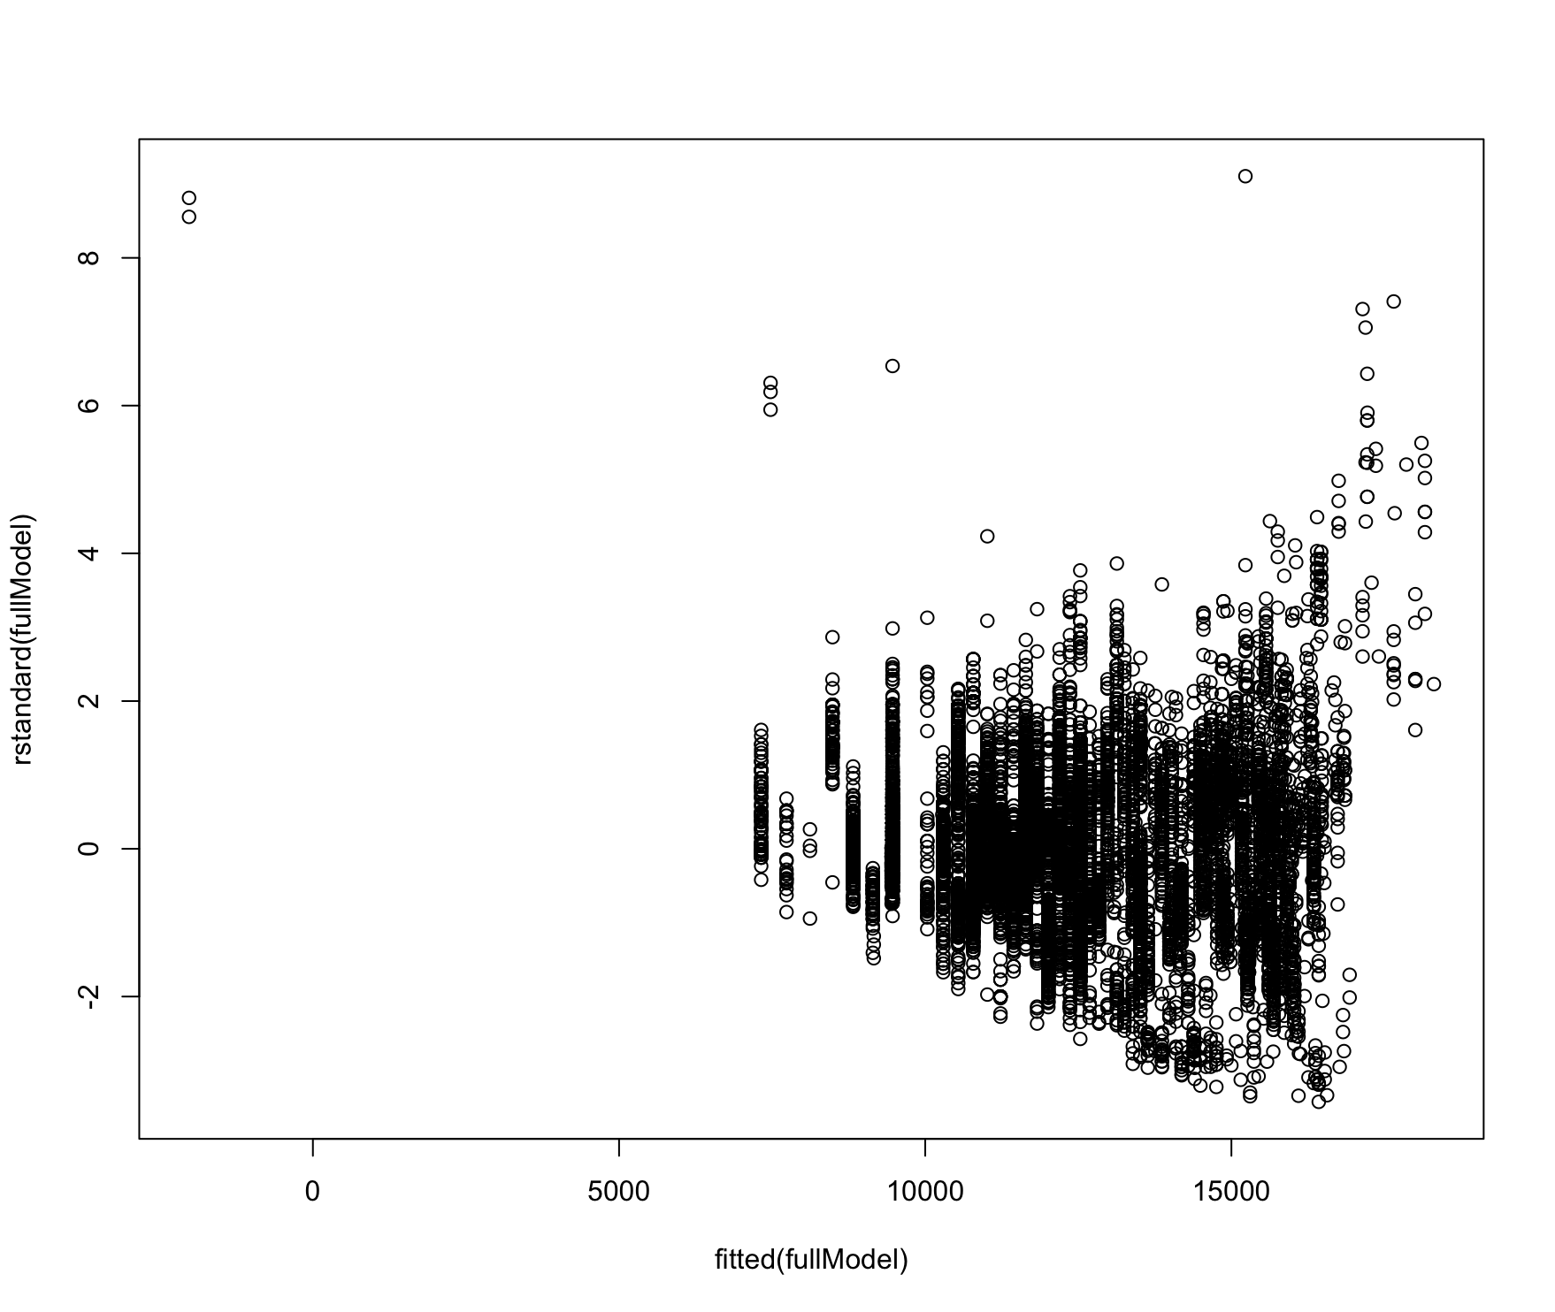
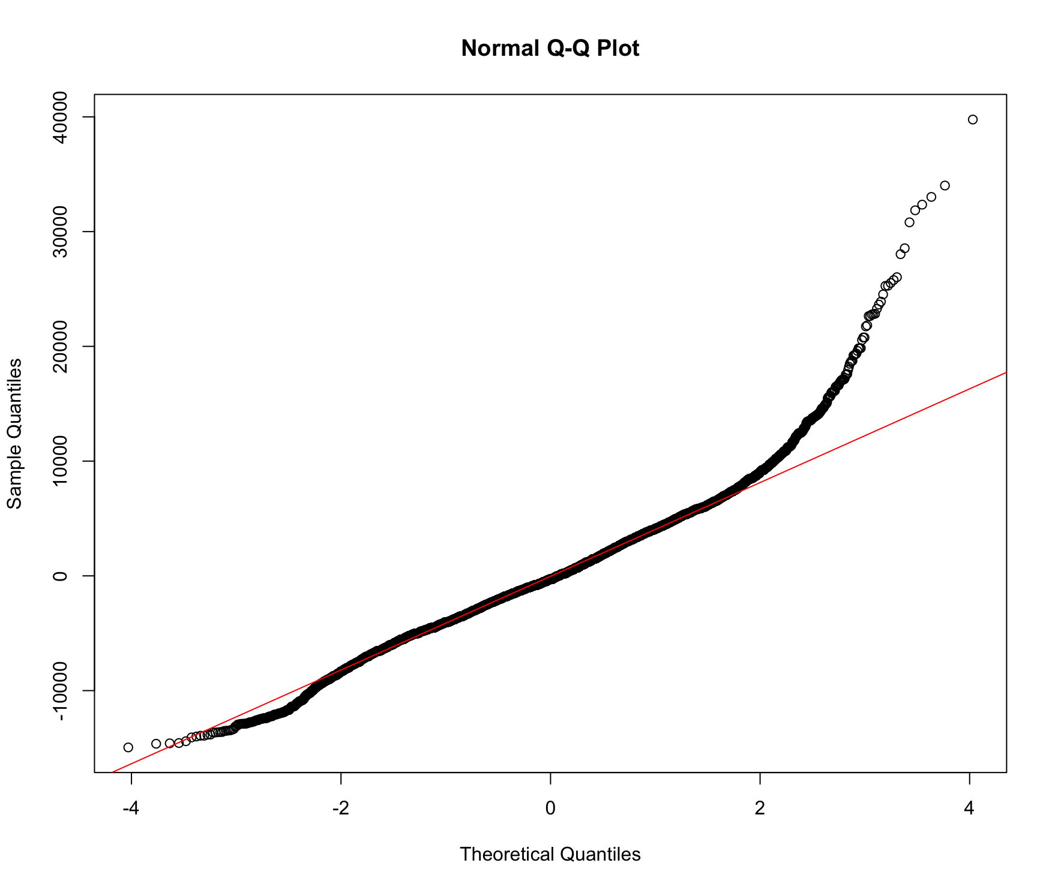
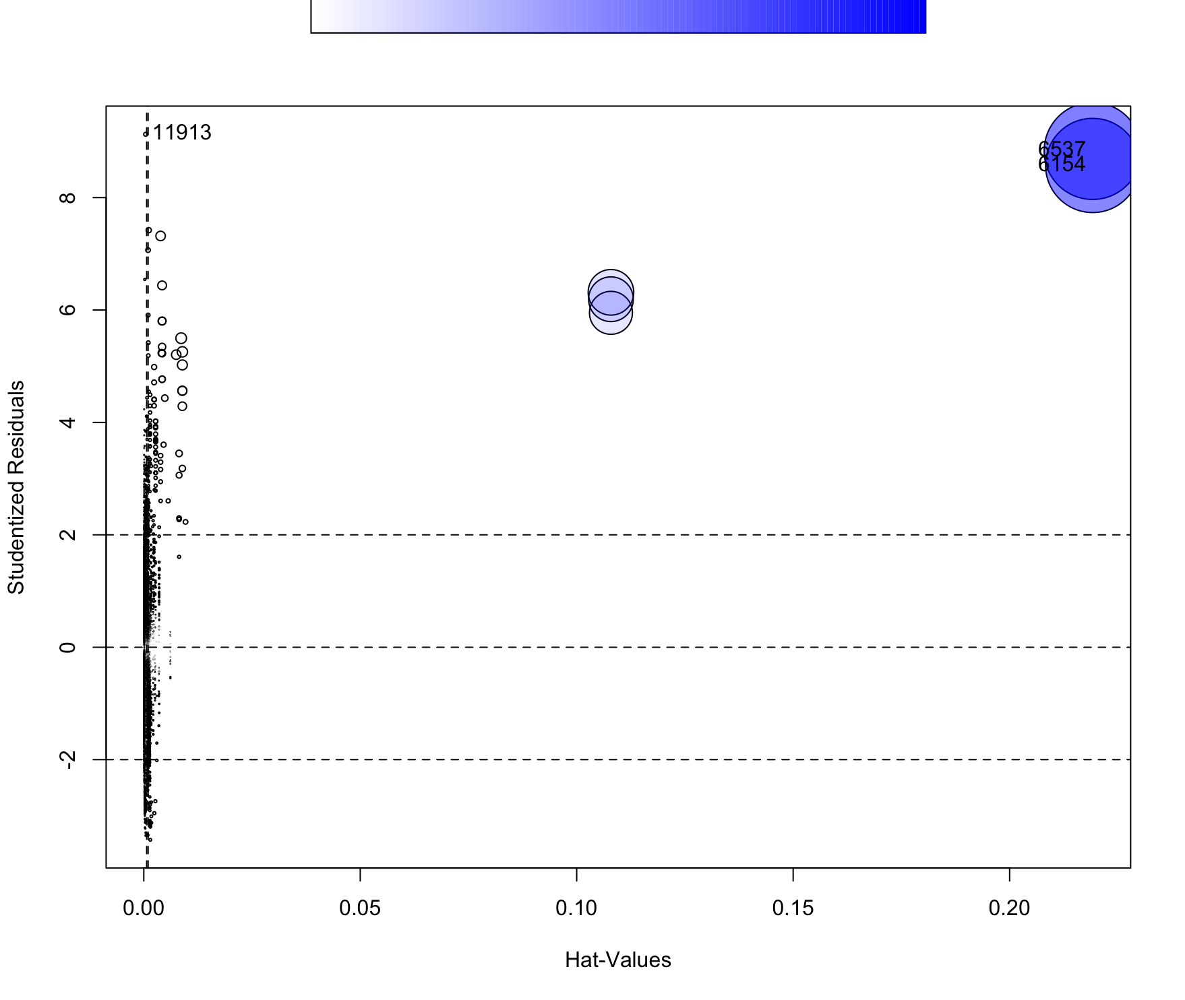
Plots

Slide 11
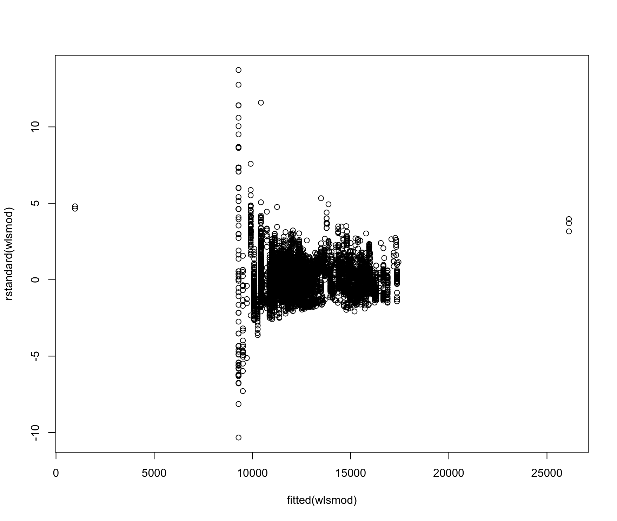
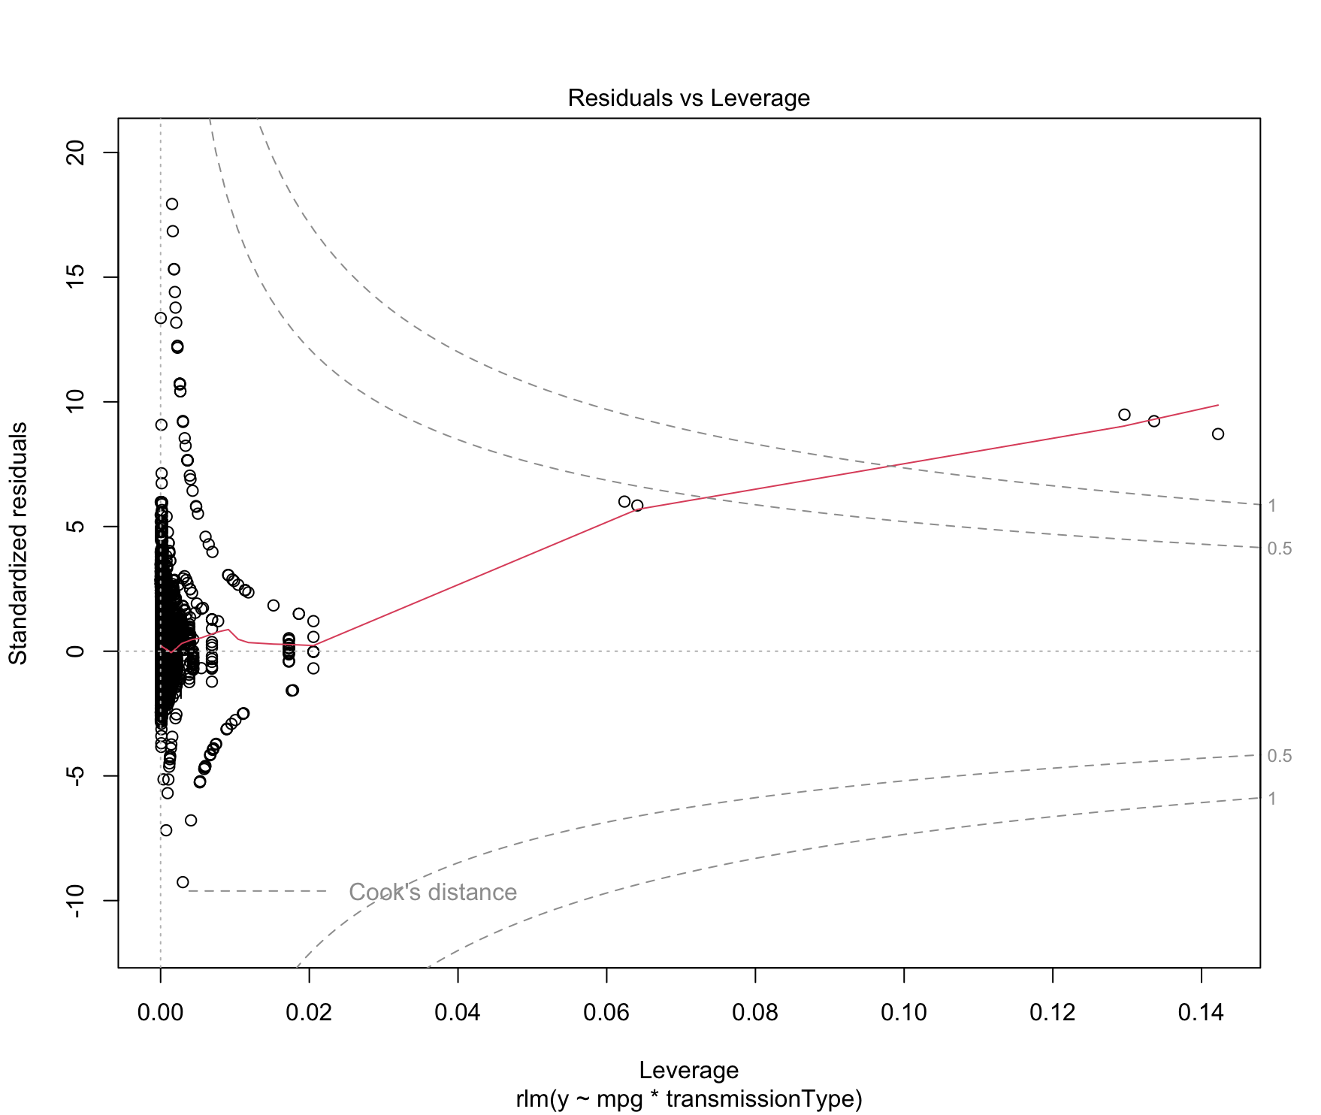
Model Remedies
Box-Cox
Lambda: 0.5
Breusch-Pagan: p-value < 2.2e^-16
Shapiro-Wilk: p-value < 2.2e^-16
Didn’t work
WLS
Breusch-Pagan: p-value = 1
Shapiro-Wilk: p-value < 2.2e^-16
Robust Regression
Breusch-Pagan: p-value = 1
Shapiro-Wilk: p-value < 2.2e^-16

Slide 12
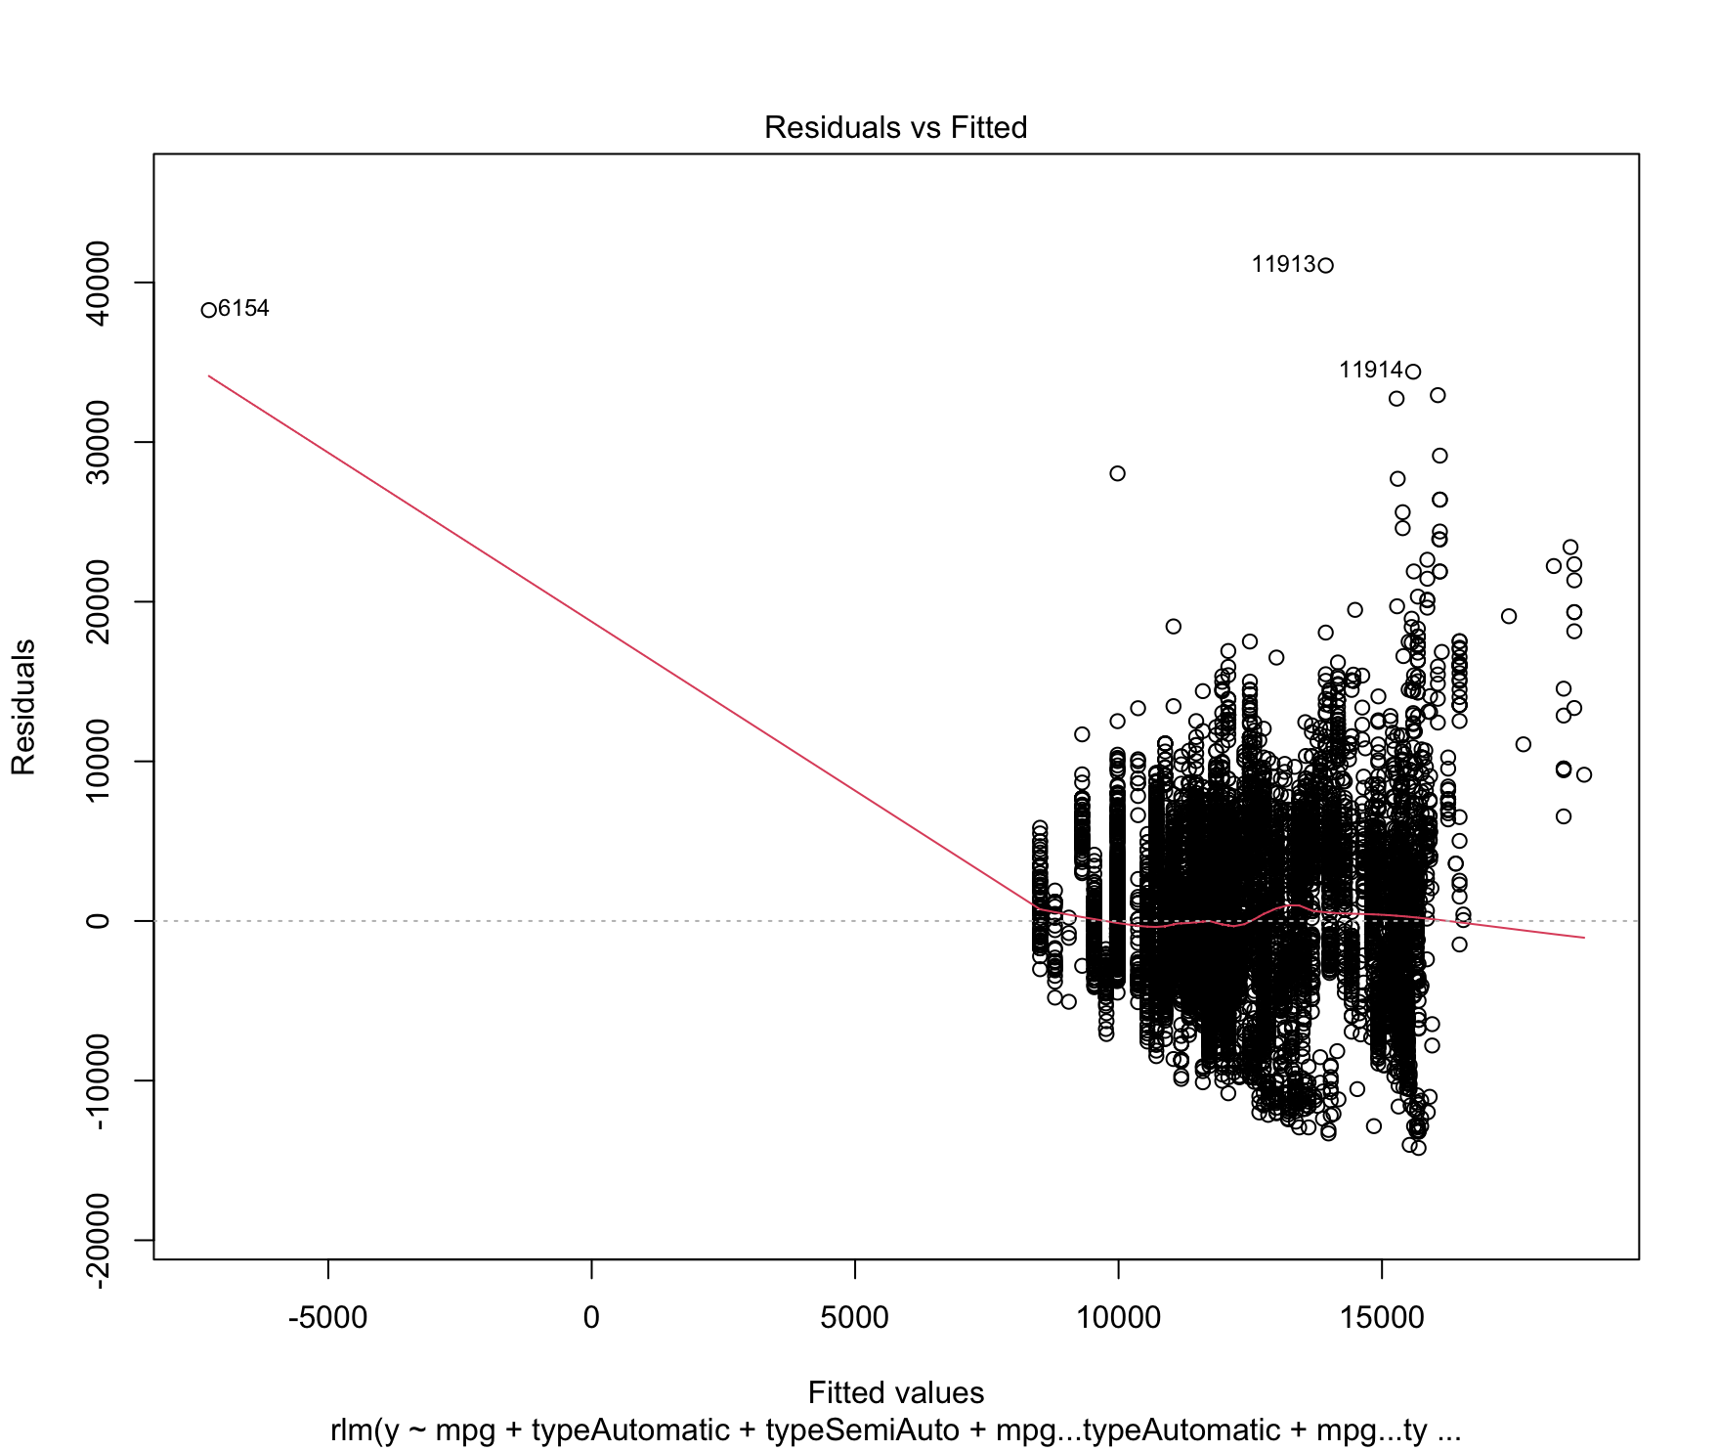
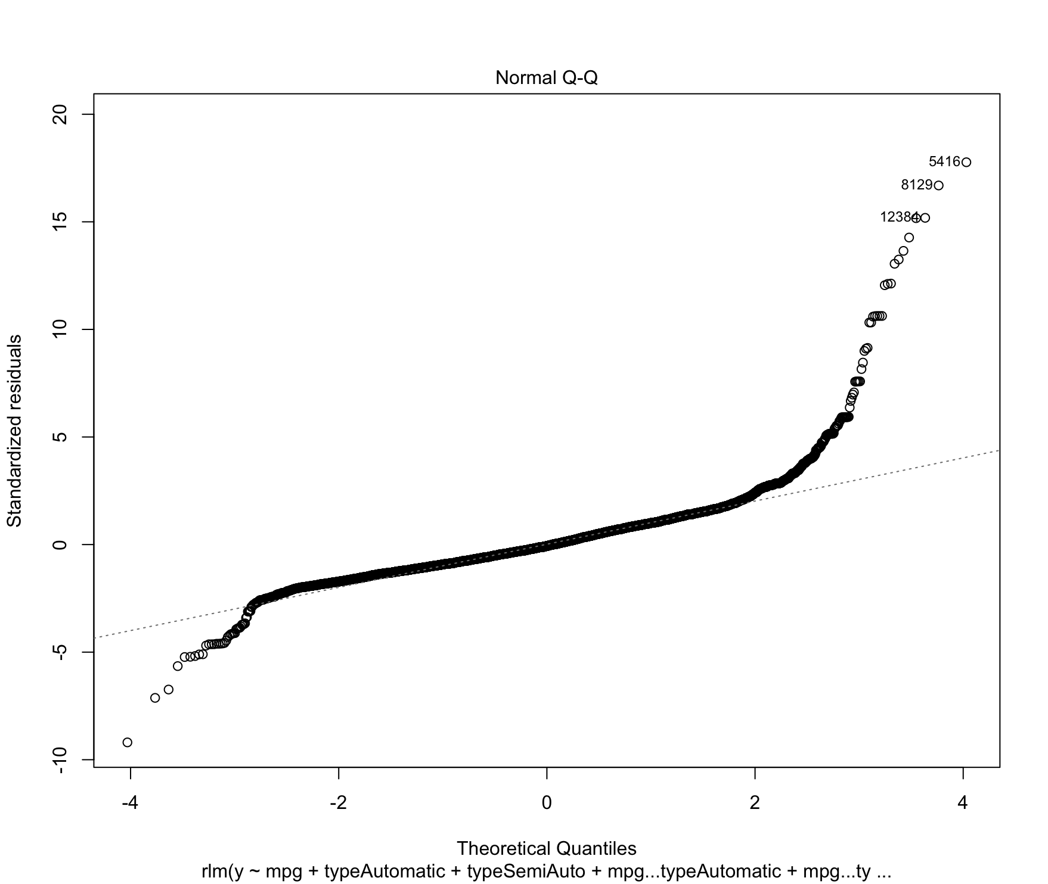
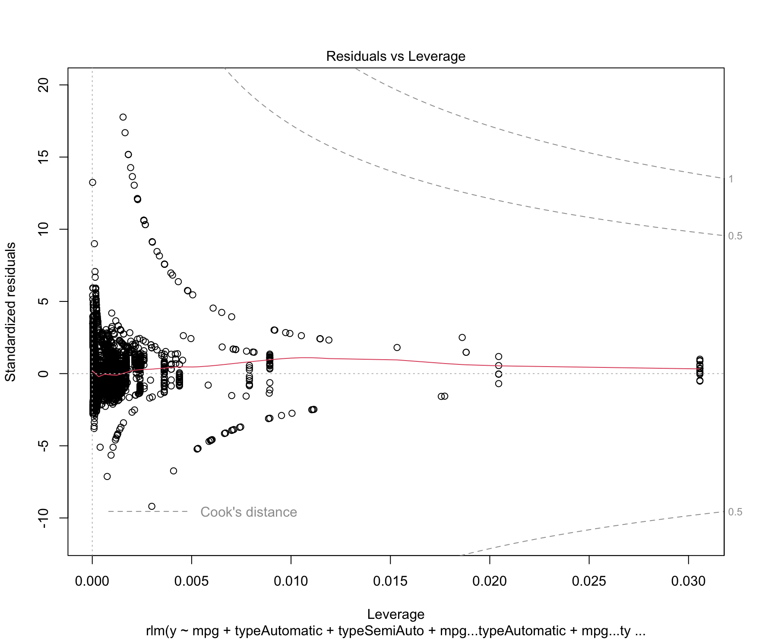
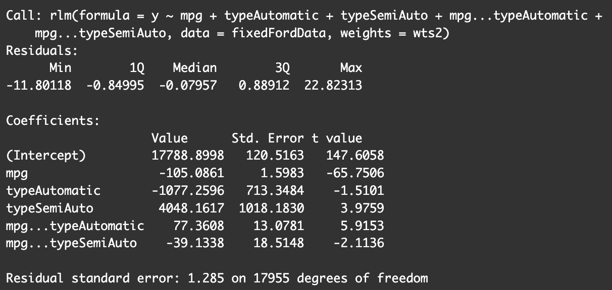
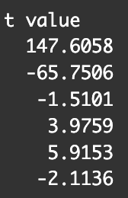
Final Model & Hypothesis Test
Removed points of major influence after robust regression
Breusch-Pagan: p-value = 1
Shapiro-Wilk: p-value < 2.2e-16
Hypothesis Test
H₀: β₆=β₇=β₄₆=β₄₇=0 Ha: β₆≠0 or β₇≠0 or β₄₆≠0 or β₄₆≠0
Full: Y=17788.8998-105.0861X₄-1077.2596X₆+4048.1617X₇+77.3608X₄X₆-39.1338X₄X₇
Reduced: Y=X₀+β₆X₆
Critical t-value: t(1-0.05/2, 17961-6) = 1.960096
Conclusion: Since all but one variable is significant, we reject the null hypothesis. Thus, the addition of transmission type does improve the model for predicting the price.

Slide 13
The Effect of Age and Mileage on Price

Slide 14
Is the effect of age (X1) and mileage (X2) on price (Y) statistically significant?
Model Selection
Price (Y): Dependent variable representing the transformed vehicle price.
Mileage and Age (X): Independent variables included to predict vehicle price.
Transformation Applied: Box-Cox transformation with lambda = 0.4545 to address heteroscedasticity and non-normality issues.
Model Diagnostics
Heteroscedasticity:
Assessed via the Breusch-Pagan test, indicating significant heteroscedasticity in the initial model.
Residual Normality:
Evaluated using the Shapiro-Wilk test, revealing non-normal distribution of residuals in the initial model.

Slide 15
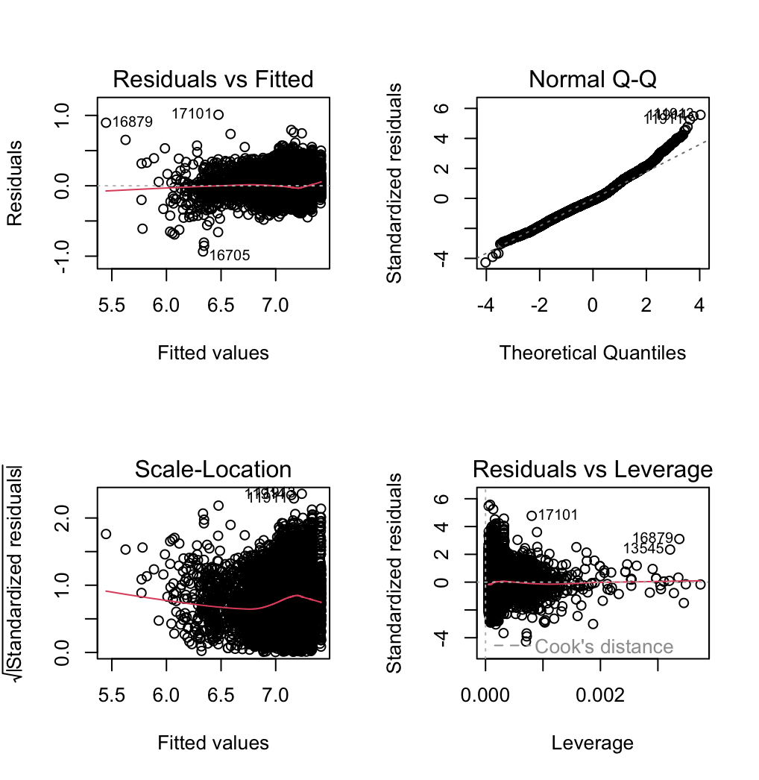
Model Remedies
Box Cox:
Lambda: 0.5
Breusch-Pagan Test:
p-value < 2.2e^-16
Shapiro-Wilk Test:
p-value < 2.2e^-16
Outcome:
Transformation did not resolve heteroscedasticity or normality issues.
WLS:
Breusch-Pagan Test:
p-value = 1 (indicates the absence of heteroscedasticity)
Shapiro-Wilk Test:
p-value < 2.2e^-16 (residuals not normally distributed)
Diagnostic Plot:
(Insert diagnostic plot image) showing residuals post-WLS regression.
Robust Regression:
Breusch-Pagan Test:
p-value = 1 (model passes test for constant variance)
Shapiro-Wilk Test:
p-value < 2.2e^-16 (residuals not normally distributed)

Slide 16
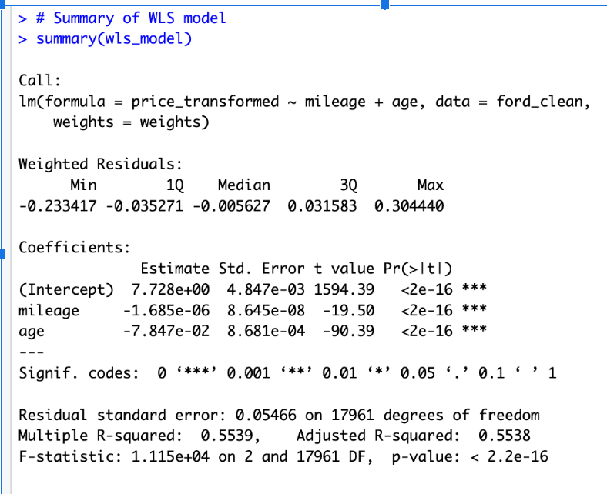
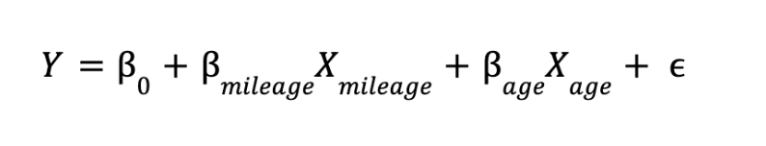
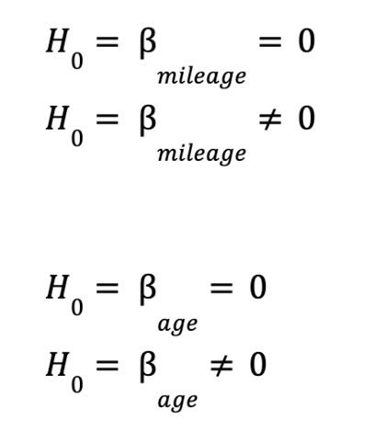
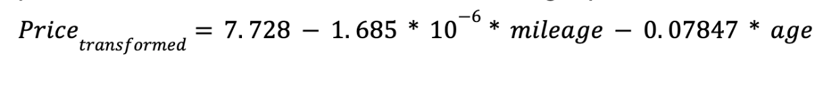
Final Model and Hypotheses Test
Model equation:
Final Model:
Hypotheses testing:
The t-values for 'mileage' and 'age' are -19.50 and -90.39, respectively. We reject the null hypothesis.
The multiple R-squared value of 0.5539 indicates that approximately 55.39% of the variability in the transformed price can be explained by the model.
Adjusted R-Squared is also similar at 0.5538. An F-statistic of 1.115e+04 and a p-value < 2.2e-16 indicates that the overall model is statistically significant.

